Slide 1
Práctica
Realizar una calculadora simple
Usando los operadores
+ - * / \ mod
Implementando la función var ()

Slide 2
Instrucciones
Crear un proyecto
Nuevo proyecto/Aplicación Windows Form
Nombrarlo: calculadorasimple

Slide 3
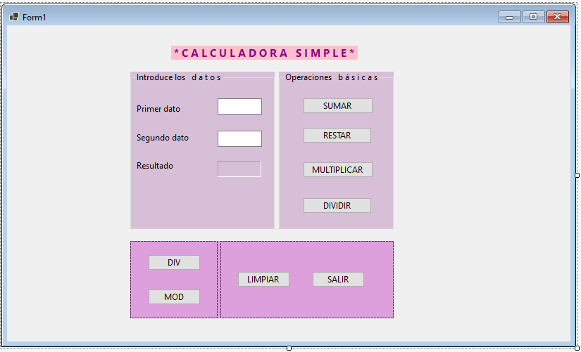
Vista diseño

Slide 4
Vista código
Public Class Form1
Private Sub Button1_Click(sender As Object, e As EventArgs) Handles Button1.Click
Label1.Text = Val(TextBox1.Text) + Val(TextBox2.Text)
End Sub
Private Sub Button2_Click(sender As Object, e As EventArgs) Handles Button2.Click
Label1.Text = Val(TextBox1.Text) - Val(TextBox2.Text)
End Sub
Private Sub Button3_Click(sender As Object, e As EventArgs) Handles Button3.Click
Label1.Text = Val(TextBox1.Text) * Val(TextBox2.Text)
End Sub
Private Sub Button4_Click(sender As Object, e As EventArgs) Handles Button4.Click
Label1.Text = Val(TextBox1.Text) / Val(TextBox2.Text)
End Sub

Slide 5
Vista código
Private Sub Button5_Click(sender As Object, e As EventArgs) Handles Button5.Click
TextBox1.Text = ""
TextBox2.Clear()
Label1.ResetText()
End Sub
Private Sub Form1_Load(sender As Object, e As EventArgs) Handles MyBase.Load
End Sub
Private Sub Button8_Click(sender As Object, e As EventArgs) Handles Button8.Click
End
End Sub
Private Sub Button6_Click(sender As Object, e As EventArgs) Handles Button6.Click
Label1.Text = Val(TextBox1.Text) \ Val(TextBox2.Text)
End Sub
Private Sub Button7_Click(sender As Object, e As EventArgs) Handles Button7.Click
Label1.Text = Val(TextBox1.Text) Mod Val(TextBox2.Text)
End Sub
End Class

Slide 6
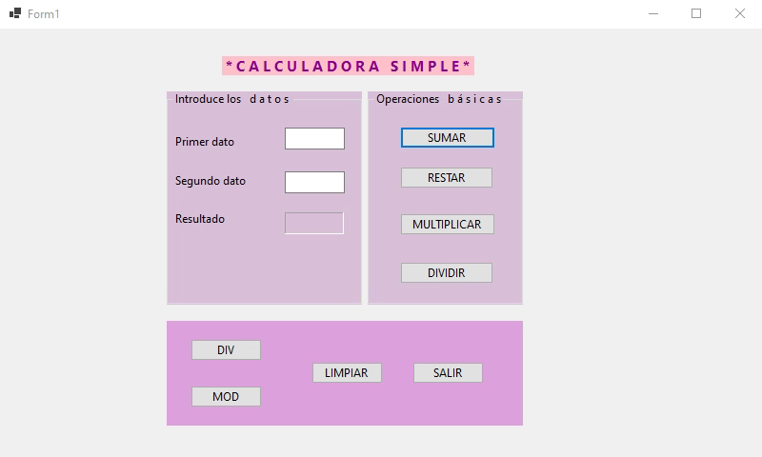
Video

